Slide 1
Secure data hiding in image using steganography
CAPSTONE PROJECT
Presented By:
Student Name :Muppidi Anjali
College Name & Department :Sri Indu College of Engineering and Technology & Cyber Security

Slide 2
OUTLINE
Problem Statement
Technology used
Wow factor
End users
Result
Conclusion
Git-hub Link
Future scope

Slide 3
Problem Statement
Traditional encryption methods make confidential data noticeable, making it a target for attackers. This project utilizes image steganography to securely hide data within images using the Least Significant Bit (LSB) method. By embedding information invisibly in pixel values, unauthorized access is prevented, ensuring covert and secure communication.

Slide 4
Technology used
🔧 Technologies Used:
Programming Language: Python
Libraries:OpenCV – For image processing
OS – For file handling and system operations
String – For text manipulation
Platforms:
Operating System: Windows
Development Environment: IDLE Pythonn libraries

Slide 5
Wow factors
Invisible Data Embedding – Unlike traditional encryption, this method hides data within images without altering their appearance.
Least Significant Bit (LSB) Technique – Ensures minimal modification to pixels, making detection extremely difficult.
Password-Protected Decryption – Adds an extra layer of security, allowing only authorized users to extract hidden messages.
Cross-Platform Compatibility – Works efficiently on Windows and IDLE Python while maintaining compatibility with other systems.
Efficient & Lightweight – Uses OpenCV and built-in Python libraries, making it fast, memory-efficient, and easy to integrate into real-world applications.
Supports Multiple Image Formats – Works seamlessly with JPG and PNG images, ensuring flexibility in various use cases.
Resistant to Basic Image Processing – The hidden message remains intact even if the image is resized or slightly modified.

Slide 6
End users
👤 End Users:
Cybersecurity Professionals – Secure communication and covert data transmission.
Government & Military Agencies – Securely share sensitive intelligence without detection.
Journalists & Whistleblowers – Protect confidential sources and leak sensitive data securely.
Corporate Professionals – Hide trade secrets and classified documents within images.
Law Enforcement & Intelligence Agencies – Use steganography for undercover operations and forensic investigations.
General Users – Safeguard personal information and messages from unauthorized access.

Slide 7
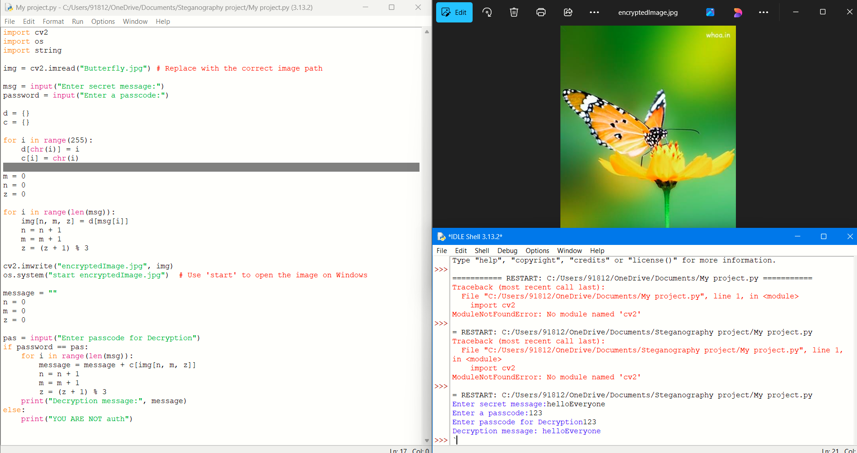
Results

Slide 8
Conclusion
This project successfully addresses the problem of secure data transmission by leveraging image steganography. Using OpenCV, OS, and String libraries within Windows and IDLE Python, we implemented a Least Significant Bit (LSB) encoding method to hide confidential messages inside images while maintaining image quality. The password-protected decryption ensures that only authorized users can retrieve hidden data, making this approach highly effective for covert and secure communication.
By implementing this technique, we provide a practical, efficient, and undetectable method for secure information exchange, preventing unauthorized interception and maintaining data confidentiality.

Slide 9
GitHub Link
🔗 GitHub Repository:
https://github.com/anjalimuppidi-79/Steganography_project-Anjali-.git

Slide 10
Future scope
🚀 Future Enhancements & Research Directions
Video Steganography – Expanding the technique to hide data inside videos for increased security.
AI-Powered Detection Prevention – Implementing AI techniques to make detection-resistant steganography.
Real-Time Steganography Apps – Developing a mobile/desktop application for instant encoding and decoding.
Multi-Layer Encryption – Combining steganography with cryptographic techniques for dual-layer security.
Cloud-Based Secure Storage – Hiding data inside images before uploading them to cloud services.
Enhancement Against Image Processing – Improving robustness to survive compression, cropping, and filtering.

Slide 11
THANK YOU

